Slide 1
Global: Obesity vs. Happiness
Abigail Metzger and Brennan Stottlemyer

Slide 2
Core Message
After examining the relationships between the happiness scores, obesity rates, life expectancy, and GDP on a global scale we were able to determine these factors are more closely correlated than we initially thought.

Slide 3
Data Sources
Happiness Data- Kaggle
Obesity Data- Our World in Data
Life Expectancy Data- World Bank
GDP Data- World Bank
Notes:
Our initial question was inspired by an article in the Independent stating that overweight people tend to be happier.
We examined data for 2016 and found consistent data for 134 countries.

Slide 4
Technical Process
Cleaned
Merged
Created Visualizations
Renamed columns
Filtered data sets to show only 2016
Inner merged all 4 data sets on country
Created scatterplots compare these metrics

Slide 5
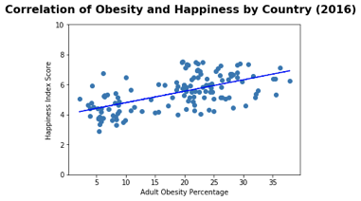
Data Analysis
Initial question
More correlation than anticipated
p-value 2.86 ^{e-14}
Prompted us to look in to other factors

Slide 6
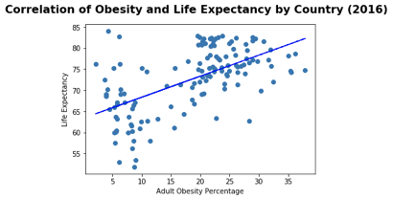
Data Analysis
More correlation than obesity vs. happiness
p-value 5.5 ^{e-14}
Interesting trend at >10% obesity
Economic factor?

Slide 7
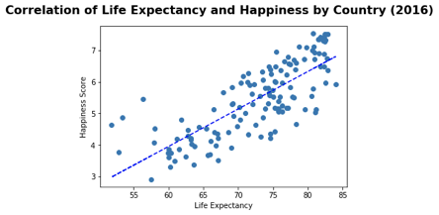
Data Analysis
Assume positive correlation based off of our two previous graphs
Verified by low p-value
p-value 6.03 ^{e-29}

Slide 8
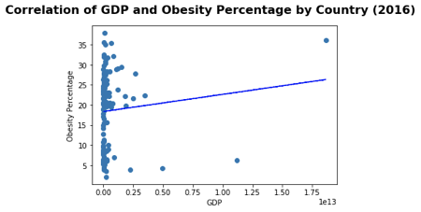
Data Analysis
Curious about an economic factor in relation to obesity
Outliers impacted the readability of the plot
USA
China
Determined not to be statistically significant
P-value 0.11

Slide 9
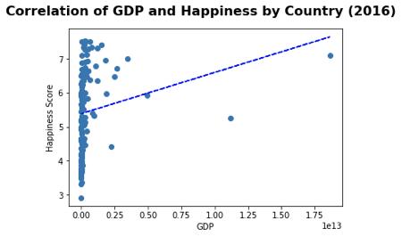
Data Analysis
Outliers impacted the readability of the plot
GDP and happiness were found to be correlated
p-value 1.04^{e-08}

Slide 10
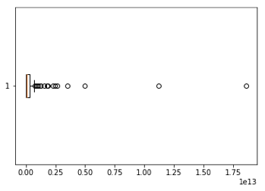
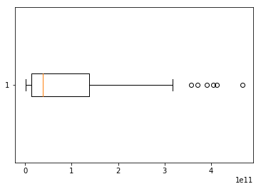
Data Analysis
Outliers impacted the readability of the plot
Created GDP boxplot to identify the impact of the outliers
Removed values outside of the original IQR
Created revised GDP box plot

Slide 11
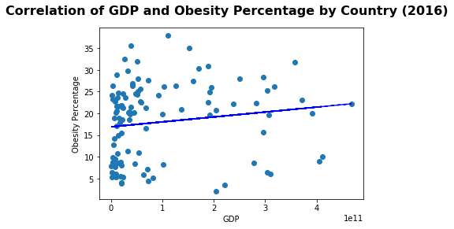
Data Analysis
Initial outliers removed
With and without the outliers there was no statistical significance found

Slide 12
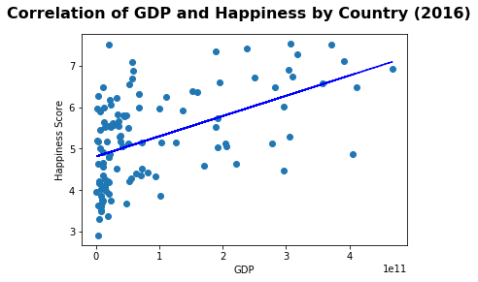
Data Analysis
Initial outliers removed
The correlation ended up being significant
p-value 1.04^{e-08}

Slide 13
Implications of Project
There is a statistically significant correlation between obesity and happiness.
People within countries with high obesity rates tend to be happier.
Other factors that could be associated with obesity and happiness include life expectancy and GDP.
There are likely other social factors that could contribute to the correlation between obesity and happiness. We decided to take a closer look at two of them.
Life expectancy had a statistically significant correlation with both obesity and happiness.
Countries with higher obesity rates tend to have longer life expectancies and country with longer life expectancies tend to be happier.
GDP did not have a statistically significant correlation with obesity, however, there was a statistically significant correlation with happiness.
Countries with a higher GDP tend to be happier.
Notes:
Mention: we expected there to be a positive correlation between all of the factors. Through our analysis we were able to verify just how closely these factors were correlated. We were surprised to see there was not correlation between GDP and obesity.

Slide 14
Difficulties and Additional Questions
Difficulties:
Finding data sets that fit the year and set of countries that we needed
When merging the data sets we lost counties due to not all the data sets having values for each country
Additional questions:
What would the correlation between obesity and happiness look like if we examined it at a state by state level in the United States?
Did not have have the time or resources to examine all of the potential social factors
Family size
Average income by houseshold

Slide 15
Questions?

